Slide 1


Testing at Scale with Docker and LambdaTest

Slide 2


That’s me 👋🏻
SPARSH KESARI
DEVELOPER RELATIONS ENGINEER
Notes:
Hii my name is Sparsh Kesari and i'm excited to be here i'm a developer relations engineer at Lambdatest where my team is building continuous quality testing cloud platform that helps developers and testers ship code faster.

Slide 3
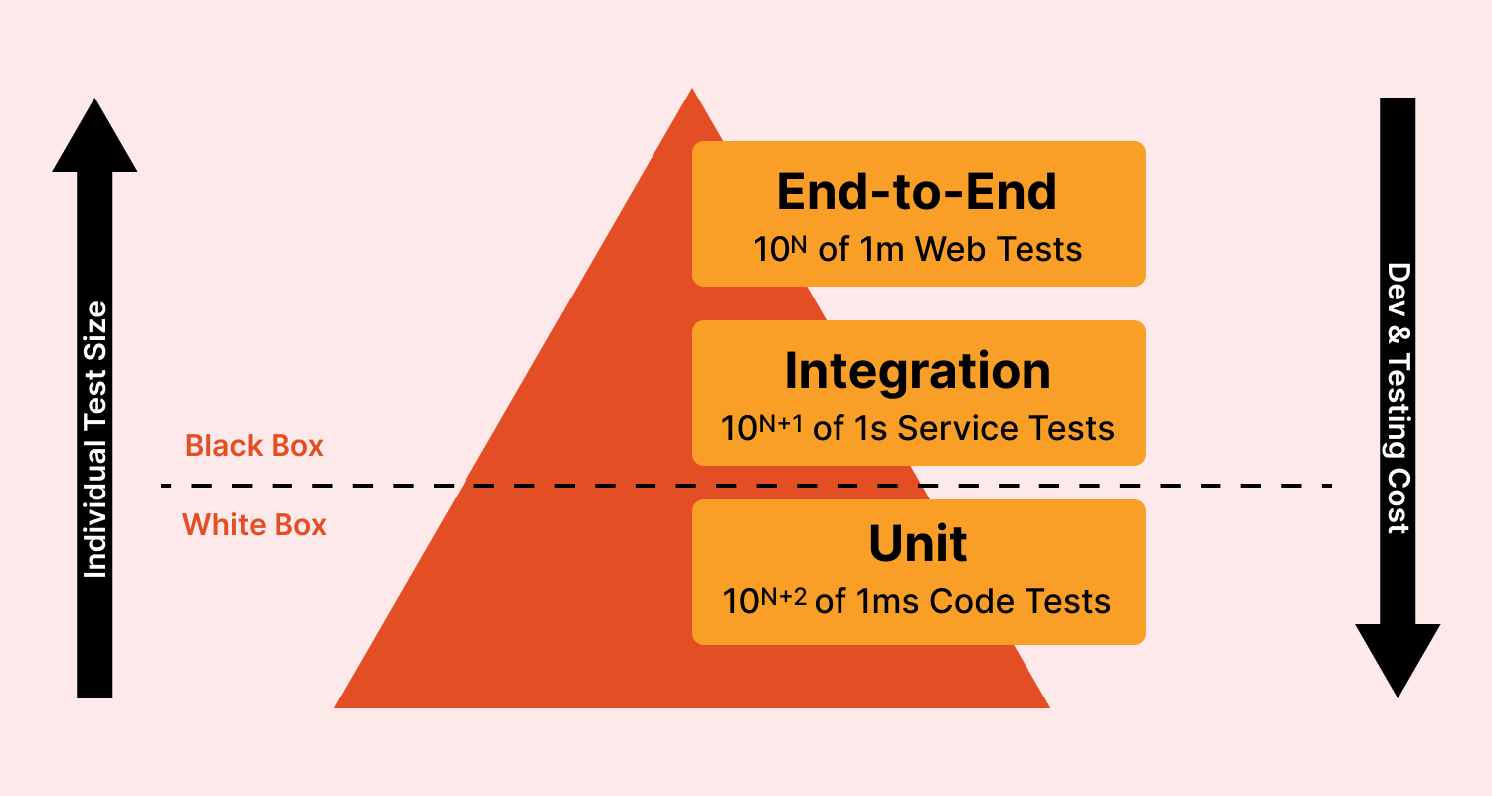
Types of Tests

Slide 4

Running Tests with Docker

Slide 5
Running Tests with Docker
Step 1: Set Up the Base Stage
Step 2: Create the Test Stage
Step 3: Build the Image with Test Stage Target
Step 4: Execute Docker Build for Testing
Step 5 : Integrate with CI/CD

Slide 6
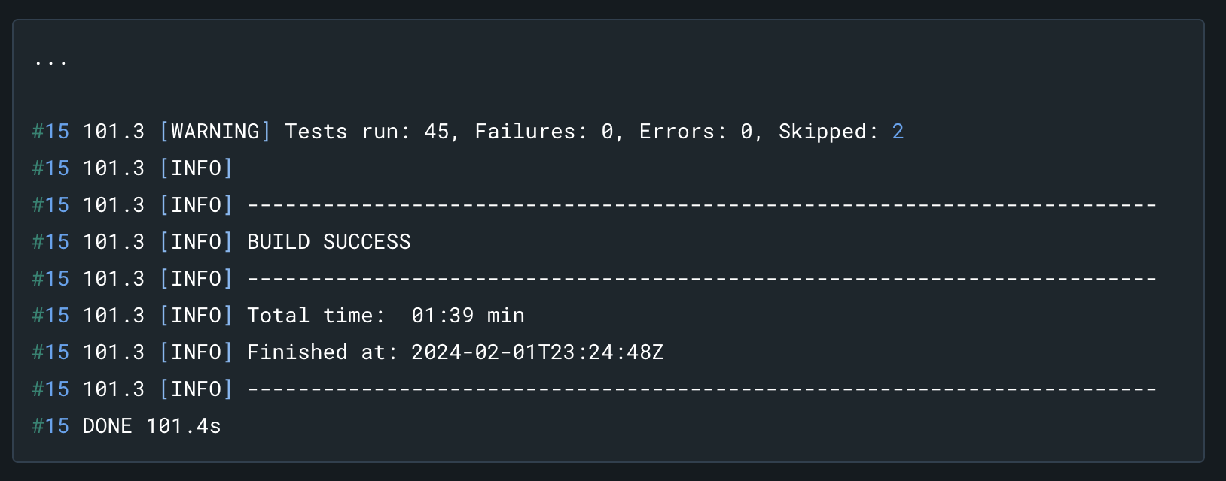
Running Tests with Docker
Output :-

Slide 7

Testing at Scale

Slide 8
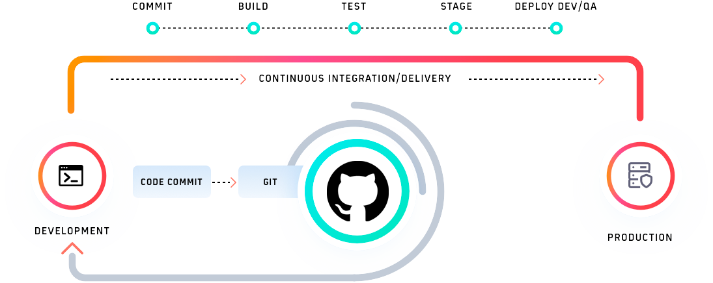
Continuous Testing
All new build releases
A build is built
Every commit
SHIFT LEFT

Slide 9
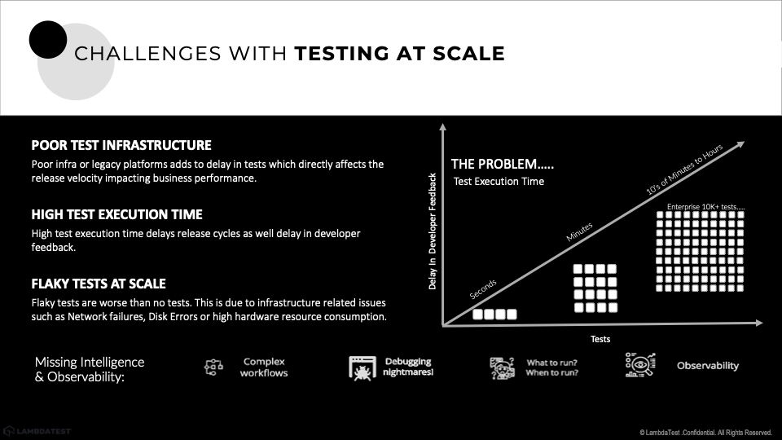

Slide 10
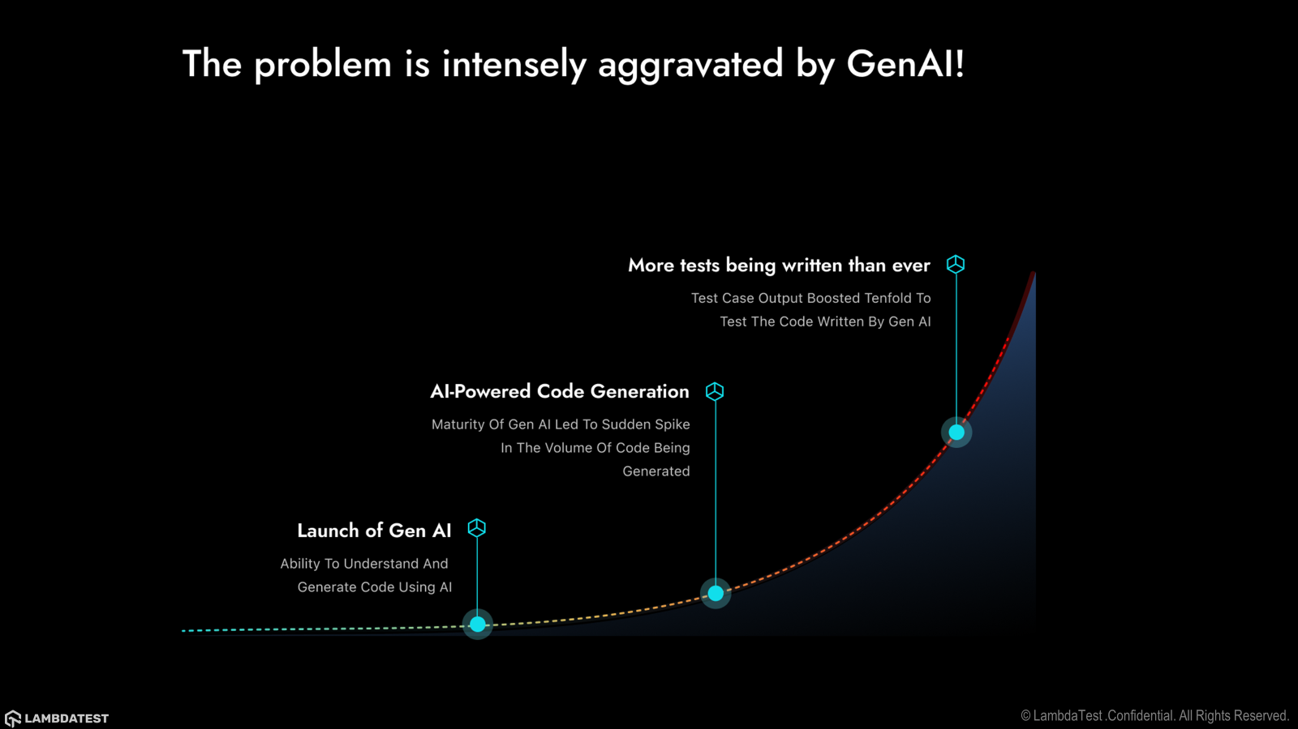

Slide 11
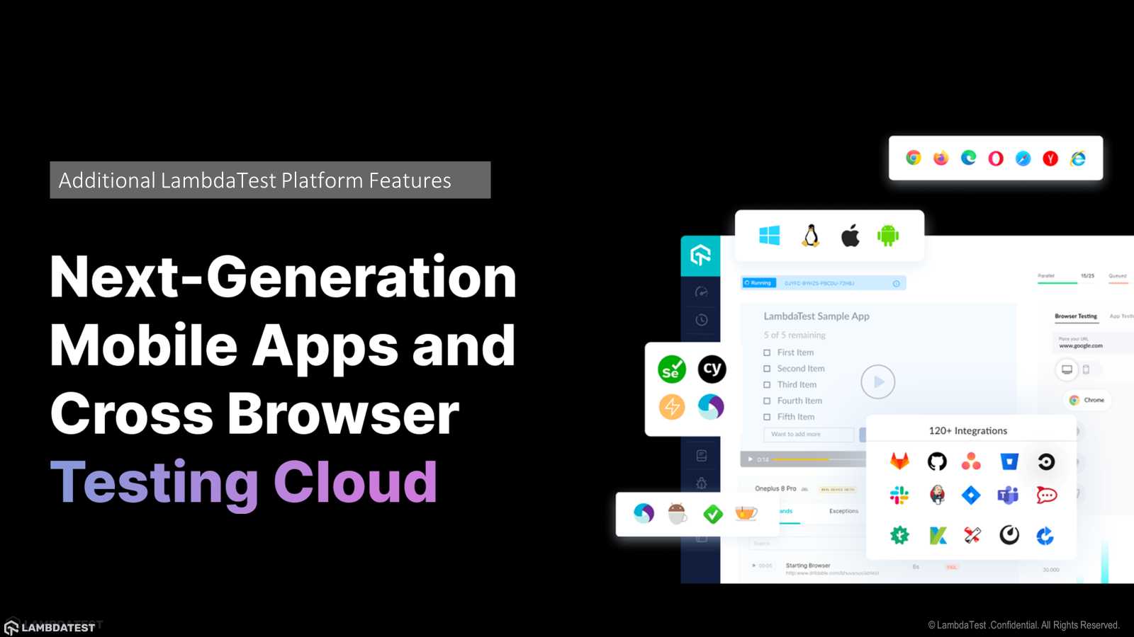

Slide 12
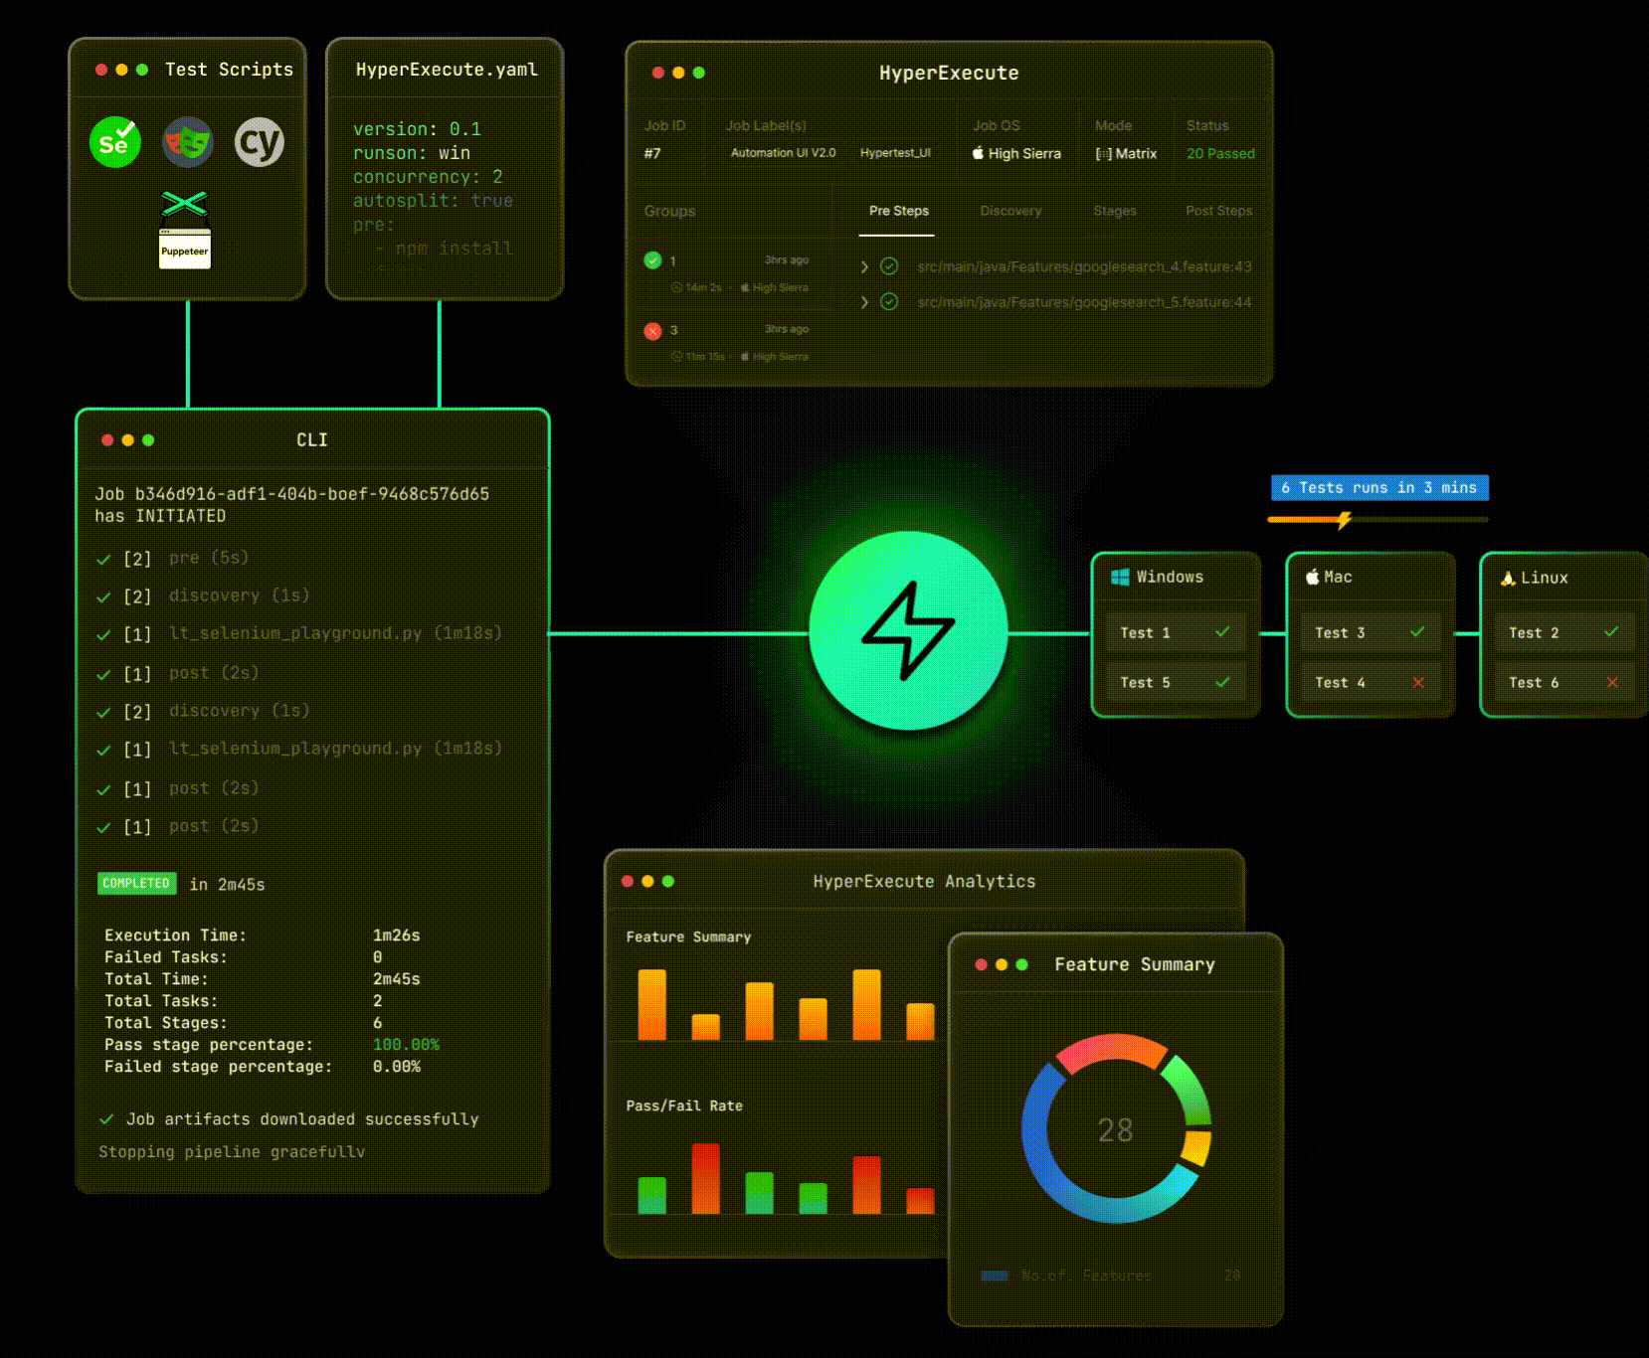
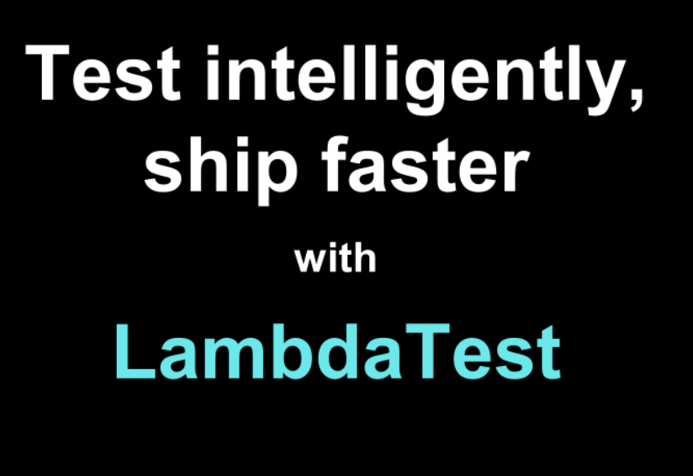

Slide 13






SMART TEST ORCHESTRATION
Smart auto test splitting over multiple machines
Automatic reordering of tests for the faster feedback
Automated identification of elements
Automatic test trigger on git hooks
Pattern Based Automatic Scheduling
Pre-steps and Post- Steps for fine grain control on test execution environment

Slide 14
Continuous Testing & AI

Slide 15
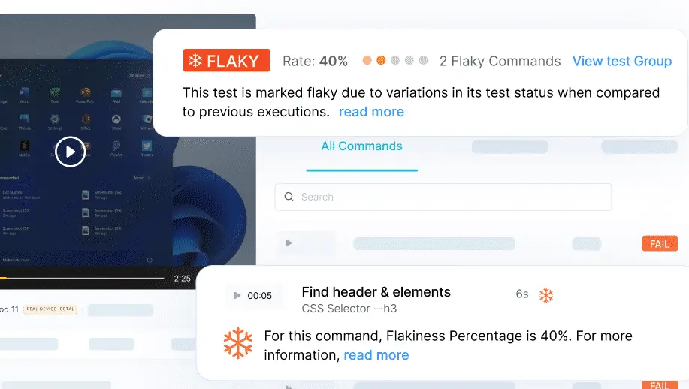

LambdaTest AI Features
Flaky Test Detection for Reliability
AI algorithms detects inconsistent test results in your test execution logs, helping you identify flaky tests with ease.
prop.test
foo.test
bar.test
prop.js
foo.js
bar.js
prop_base.js
foo_bar.js
bar_base.js
prop_util.js
prop_fun.js
foo_fun.js
foo_prop.js
bar_prop.js
bar_fun.js
@manoj9788

Slide 16
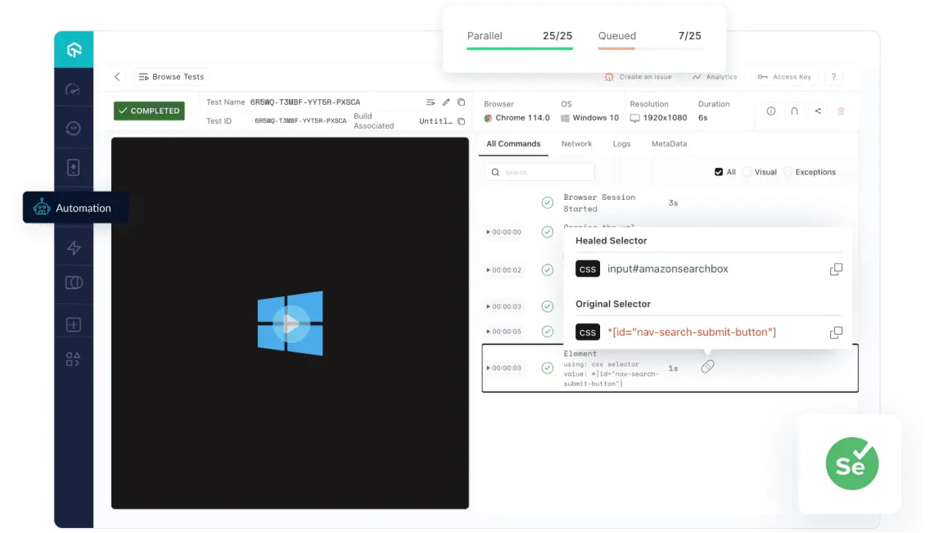
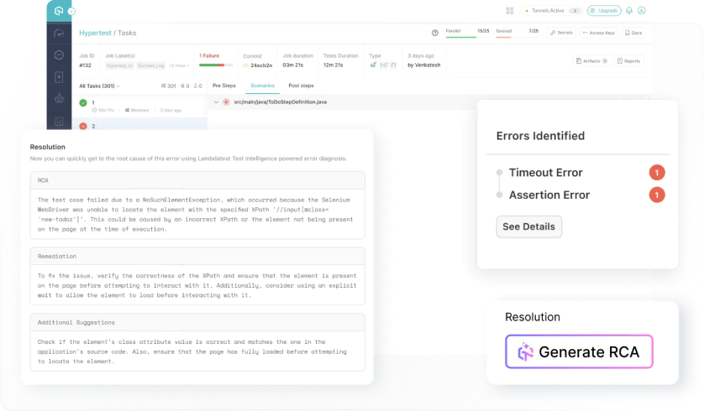
LambdaTest AI Features
Auto Healing for Dynamic Updates
Automatically recovers from certain typеs of failures during thе execution of your tеst scripts
Failure RCA for Triaging
Speed up issue resolution using RCA and categorize errors and offers recommended solutions for quick and effective problem-solving.
@manoj9788

Slide 17
Docker Extension and LambdaTest Tunnel

Slide 18
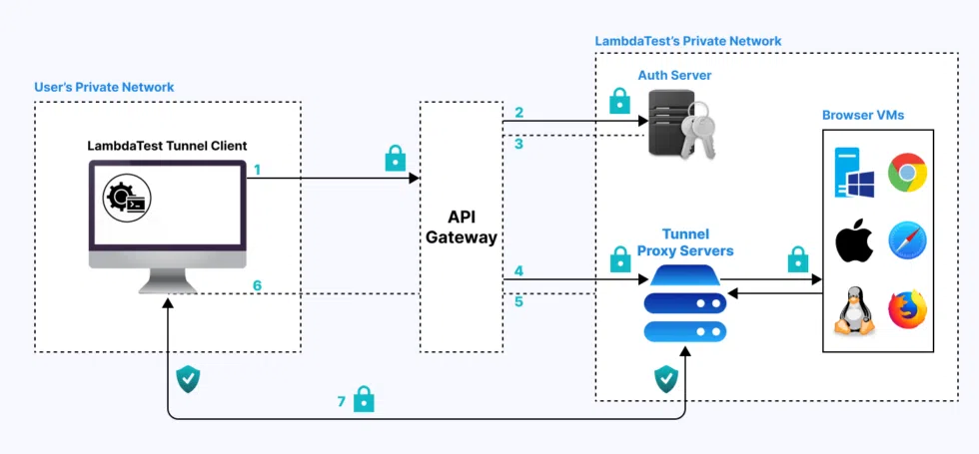
LambdaTest Tunnel

Slide 19
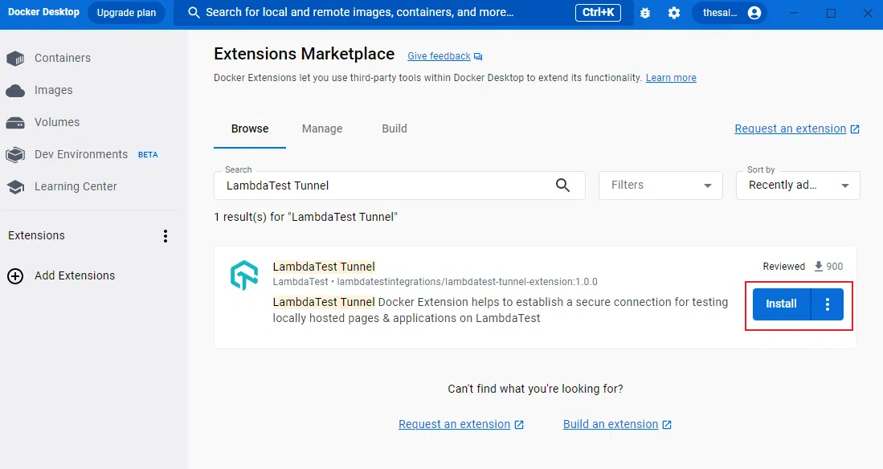
Docker Extension Marketplace

Slide 20
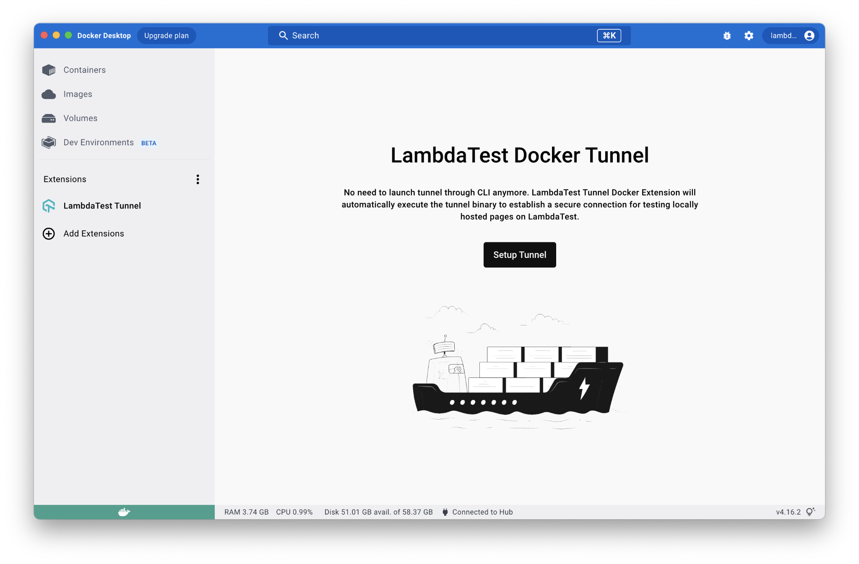
LambdaTest Tunnel

Slide 21
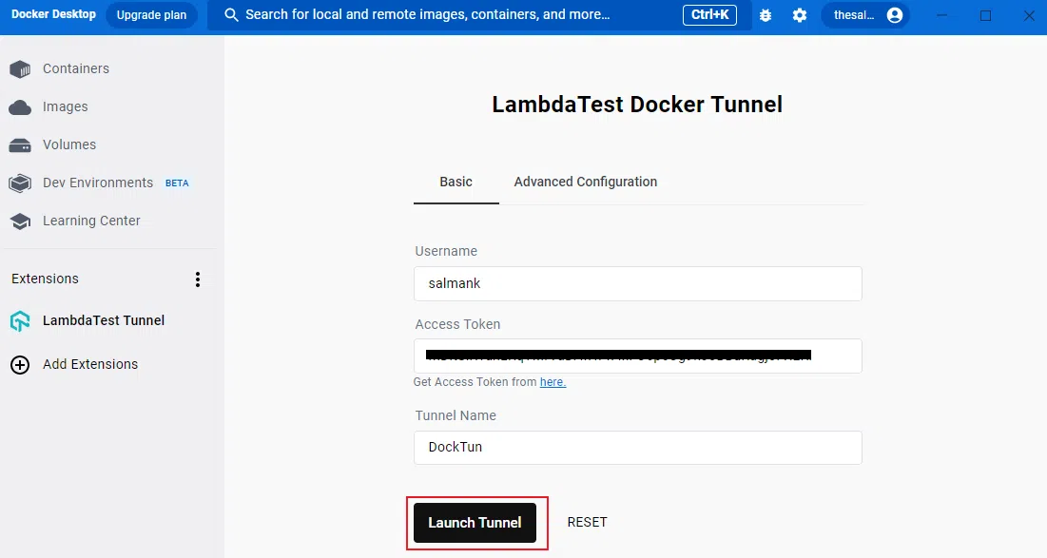
LambdaTest Tunnel

Slide 22
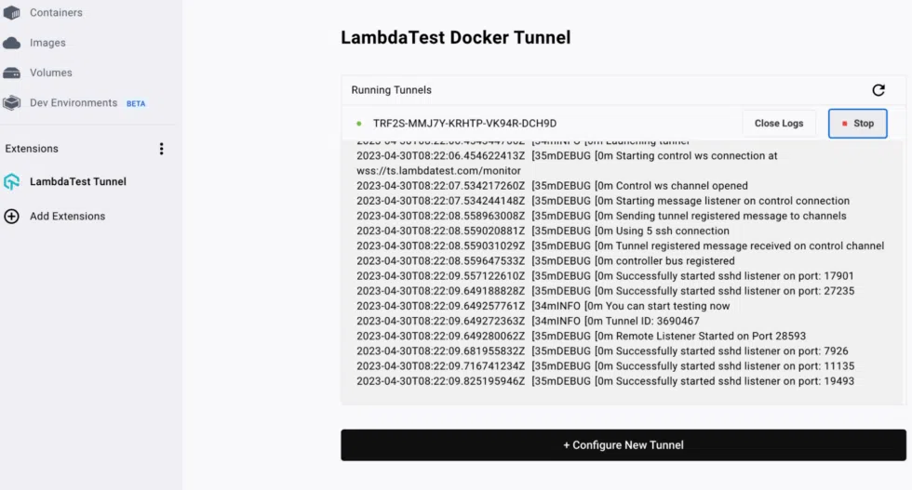
LambdaTest Tunnel

Slide 23
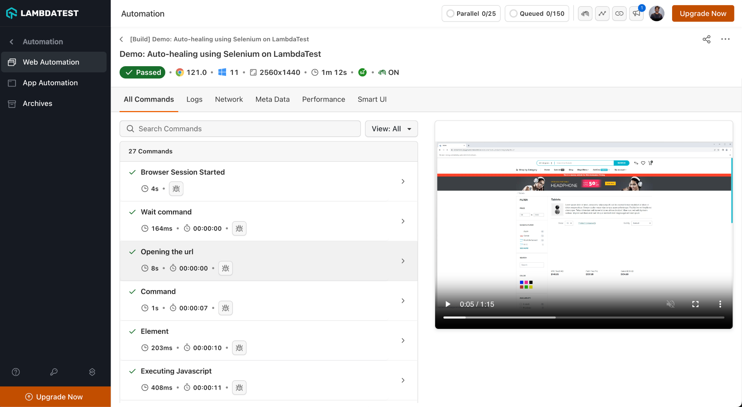

Slide 24
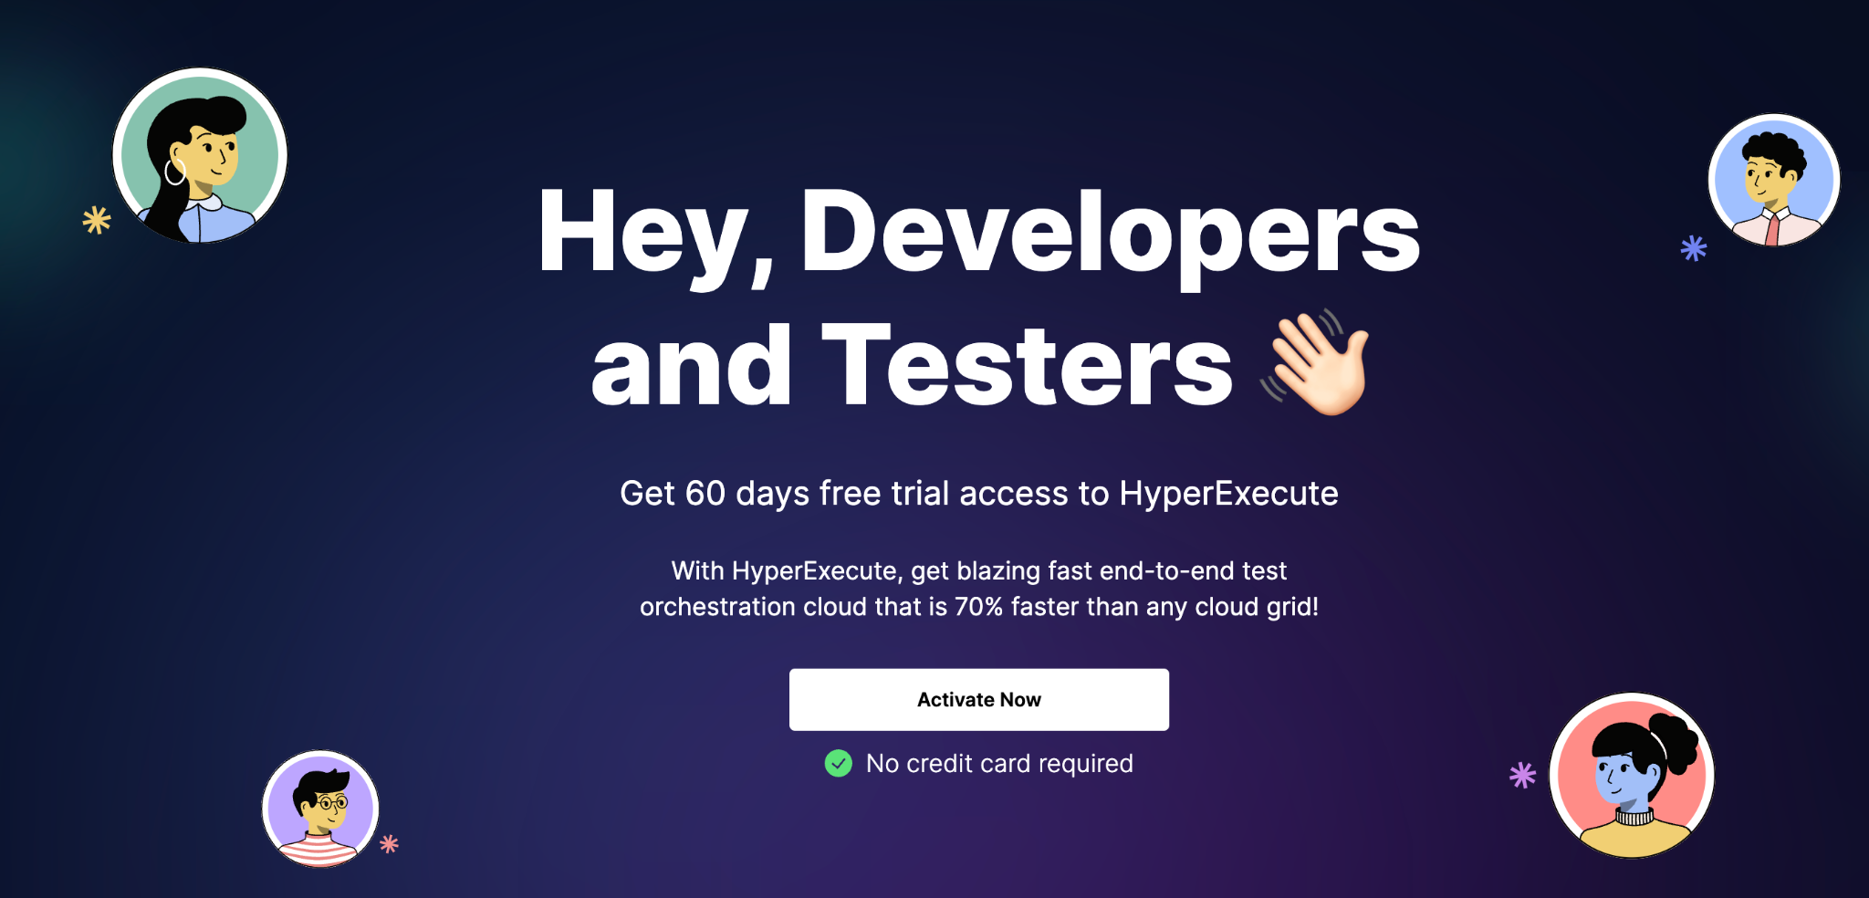
Get Free Access to HyperExecute for 60 days
© LambdaTest .Confidential. All Rights Reserved.

Slide 25
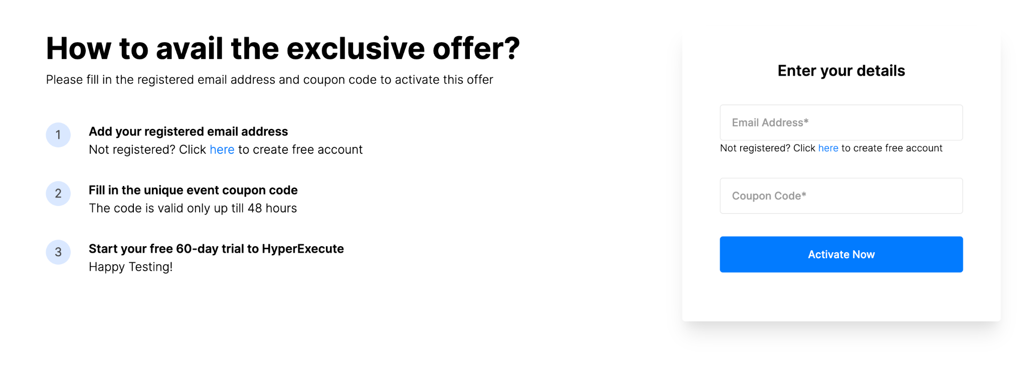

Slide 26

Get Free Access to HyperExecute for 60 days
Scan the QR Code or open using link : https://www.lambdatest.com/community-access
Exclusive Coupon Code: DOCKER | Valid till 16th March only
© LambdaTest .Confidential. All Rights Reserved.

Slide 27
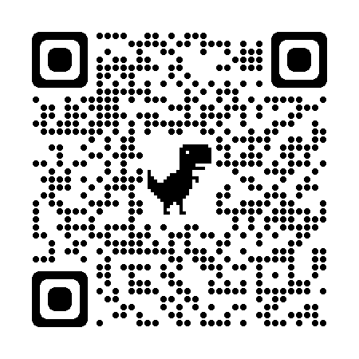



Thank You
sparshk@lambdatest.com
sparshk98
sparsh_kesari_
Notes:
Playwright can listen to browser events

